Slide 1
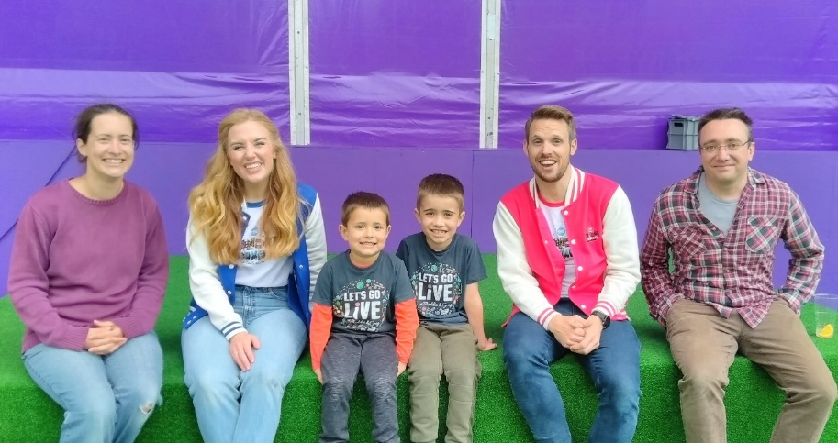
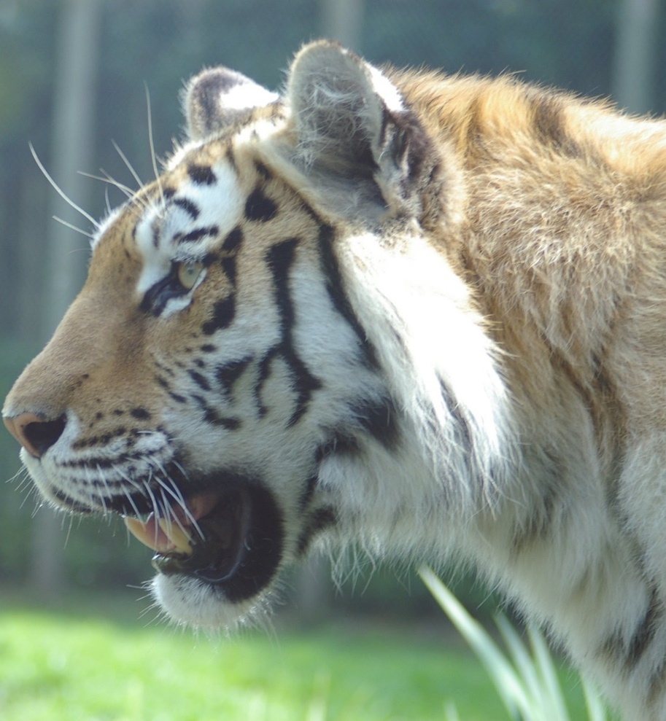
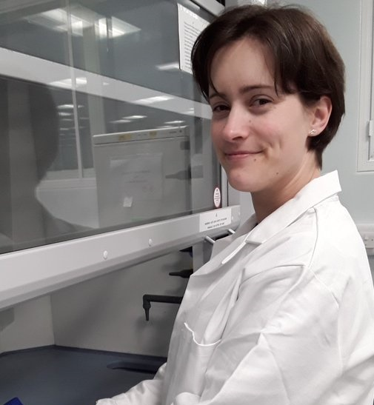
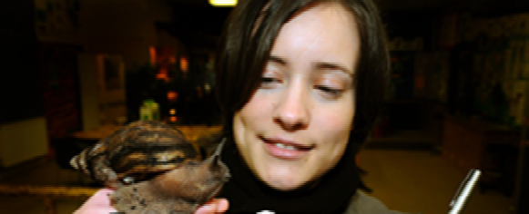
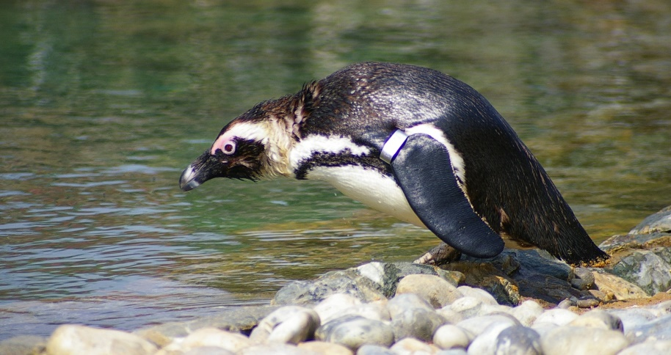
Become a Conservation Officer
I’m Clare Collins

Slide 2
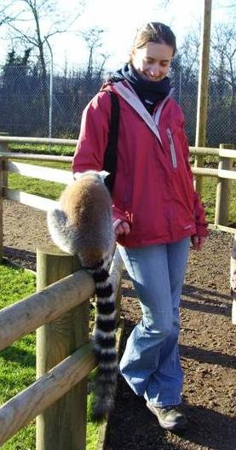
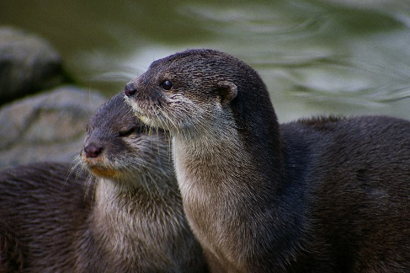
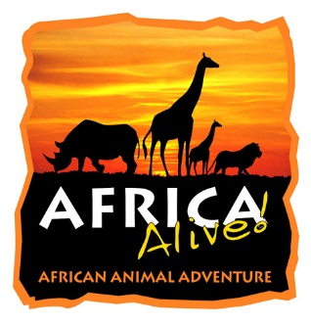

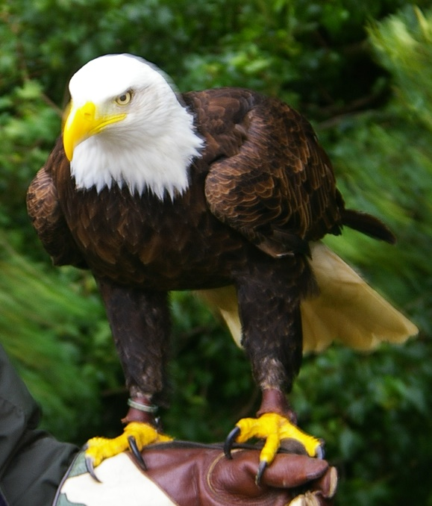
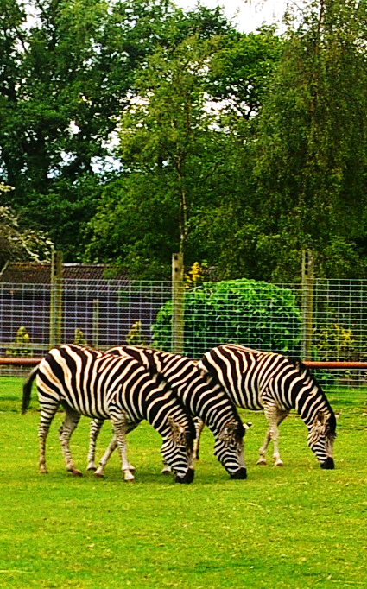
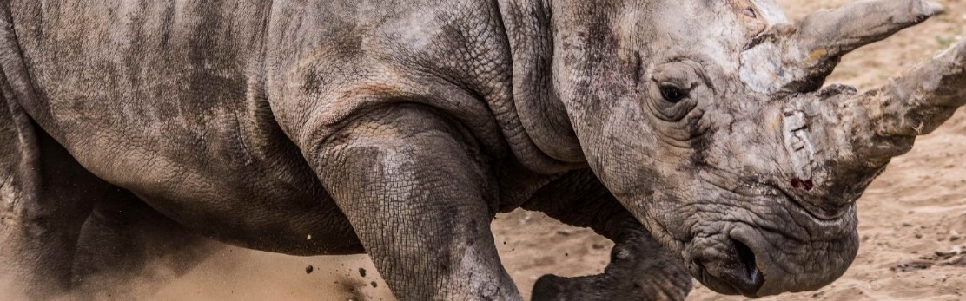
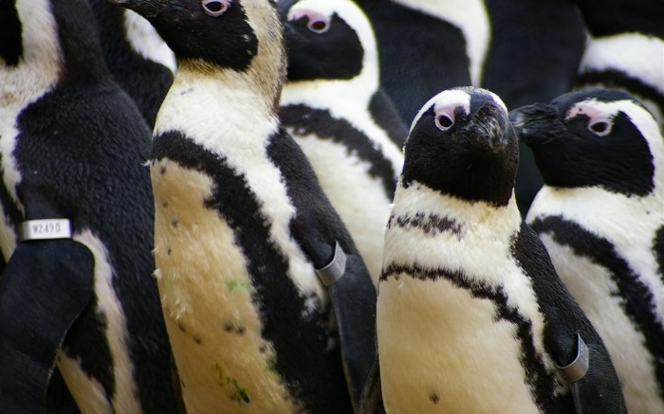
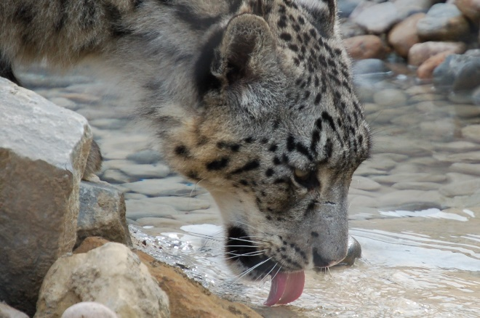
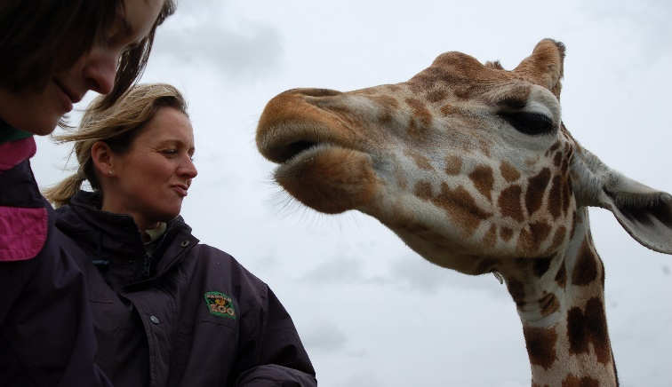

I used to work in a zoo I was a Conservation Officer!
Notes:
Talk about Bert the penguin chick who used to shelter from the sun by my leg when I ate my lunch; Caspar the Grevy’s zebra stallion who was a softie (unusual) and enjoyed a tickle behind his ear; holding Sam the giant bald eagle who was magnificent, but incredibly frightened by crows; the Siamangs who used to make my tummy rumble as they’d call out loudly at 11:30am each morning, reminding me it was nearly lunchtime

Slide 3
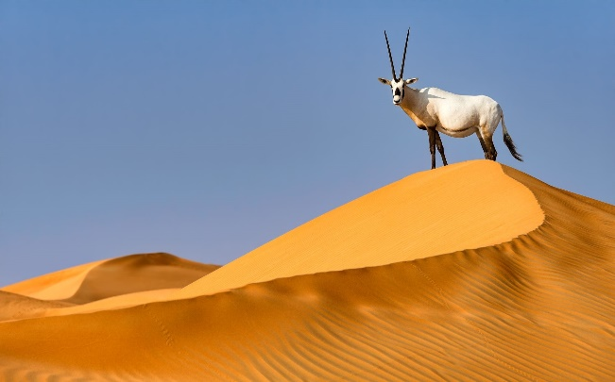
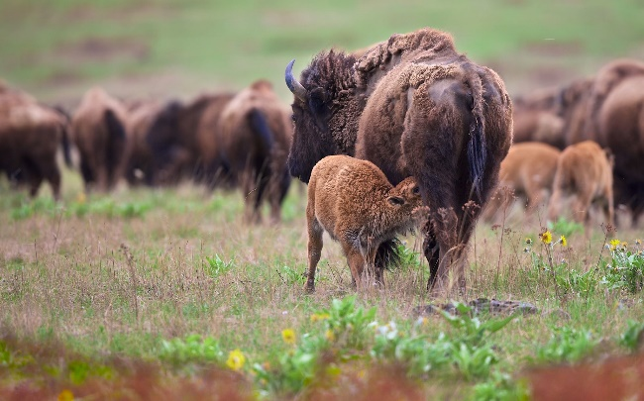
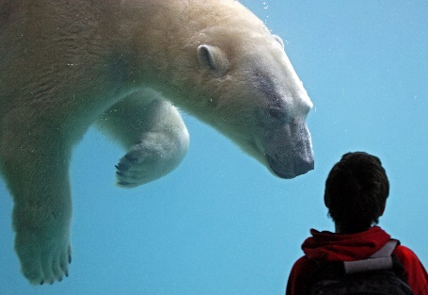
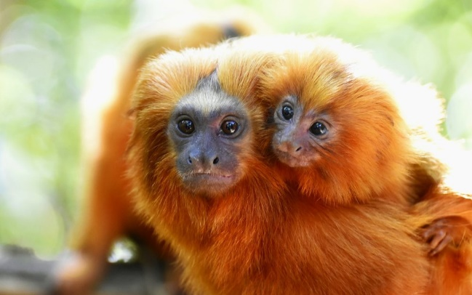
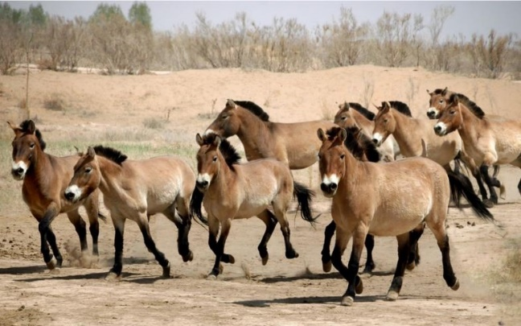
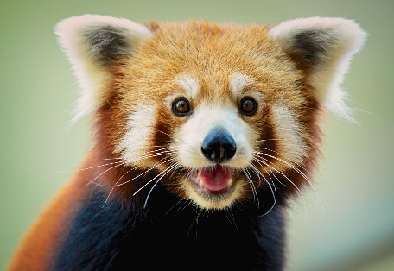
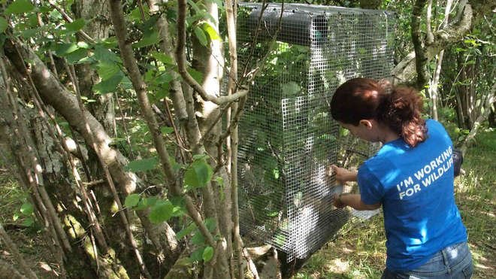
What do zoos do?
EDUCATE
RESEARCH
CONSERVATION
Notes:
EDUCATE
Spark a passion for our amazing natural world
Make people care
RESEARCH
Tools and husbandry used in zoos have been used to help animals in the wild
CONSERVATION
Examples of successful reintroductions from zoo populations: golden lion tamarin, Arabian oryx, Przewalski’s horse, European bison and here in the UK hazel dormouse
Zoos entertain visitors
Engage visitors with exotic animals
Educate about animals threatened with extinction
Spark a passion for biology, conservation and the environment
Zoos conserve Ex Situ
Breeding programmes – sustainable captive population and occasionally set up specifically as part of the In Situ work – captive breeding for release to boost wild numbers e.g. hazel dormouse, red squirrels, white-backed vultures, beavers - current programmes also include white-clawed crayfish and pool frog
Husbandry knowledge – how to look after the animals [also worth noting that techniques to identify zebras in photos using software programmes was trialled with zoo zebras initially and air samples from zoos were tested for eDNA and the zoo species identified this year, showing these techniques can be used to identify species in the wild]
Raise profile and money to fund In Situ conservation – globally zoos and aquaria raise huge amounts of money for conservation, much more than the IUCN and others (see Dick and ? paper)
Zoos conserve In Situ
Help look after wild animals with knowledge learnt in zoos e.g. elephant herpes virus, saola

Slide 4
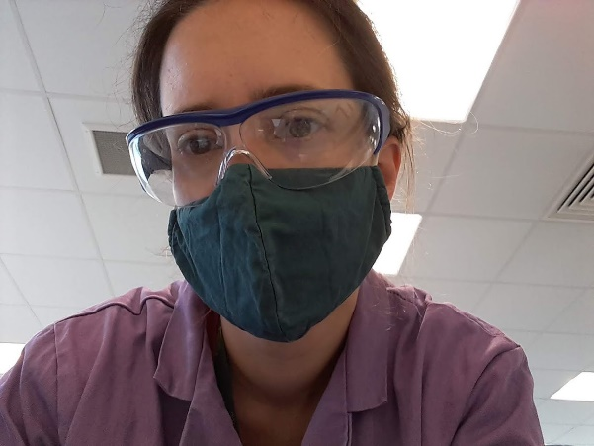
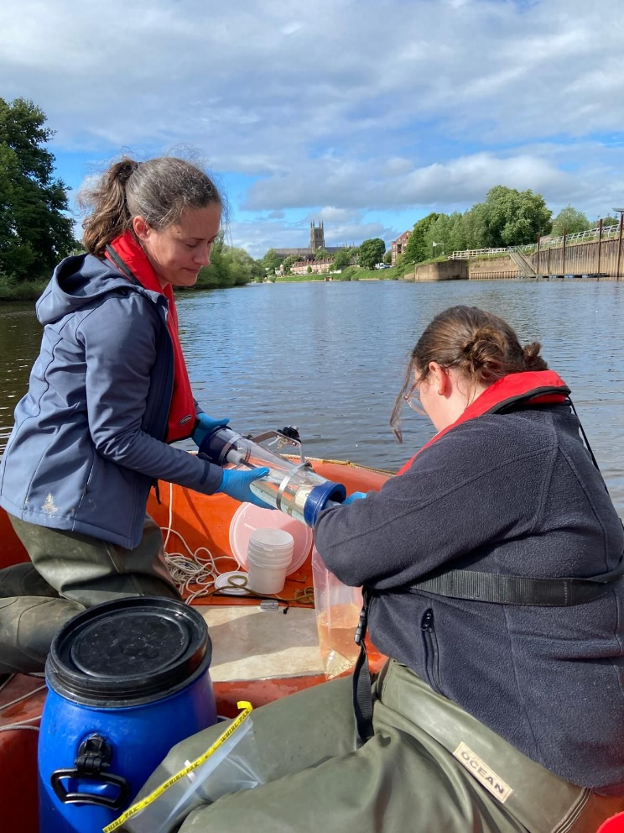
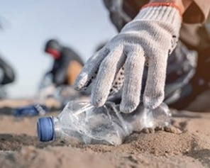
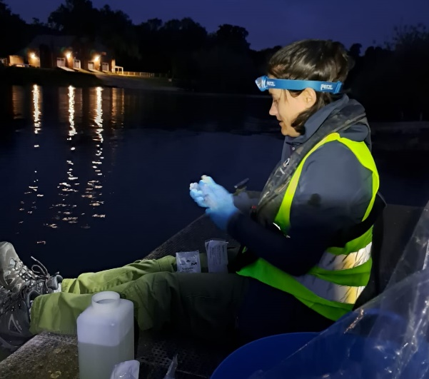
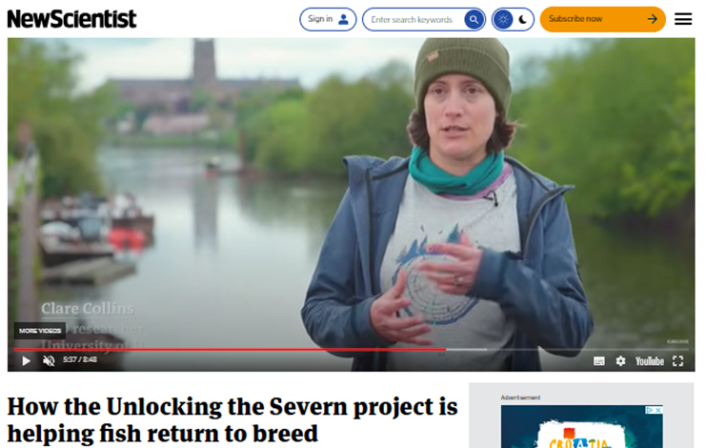




Now I am a scientist

Slide 5

What is Conservation?
Protecting species from extinction
Looking after their homes
Protecting biodiversity = variety in life from tiny fungi to the blue whale, from a puddle to a mountain
Conservation of 30-50% of Earth is required to maintain a healthy planet.
IPCC 6th Report

Slide 6
How do we do it?
Understand the threats
nowhere to live
invasive species
cause problems for humans
Choose the best solutions
monitor / survey
work with humans
limit hunting/fishing
create & manage protected area
prevent wildlife crime (e.g. pet trade, trophies & medicine)
clearing up pollution
wildlife rangers
reforestation
protect farm animals from predators and disease
protect food plants from herbivores
conservation breeding, moving, reintroduction
Notes:
Monitoring / surveying includes techniques such as bug pots in the ground to monitor bugs, cameras to capture movements, drone footage and heat maps, fishing, observations, netting birds …all sorts
Work with stakeholders includes farmers, local communities, indigenous populations, governments, other conservation organisations, hunters and other land users

Slide 7

Now it’s up to you…
YOU
Conservation Officer
…to become a Conservation Officer
Notes:
I will give you some facts about the species, tell you what is threatening the species in the wild and you lot are going to think of some solutions and then we will have a look at what has been put in place – maybe you will have some new fantastic ideas ☺

Slide 8
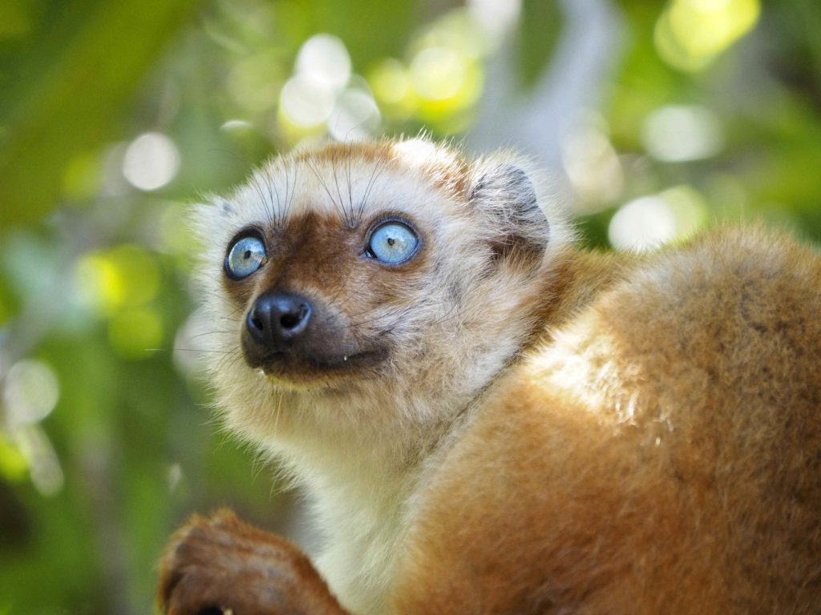
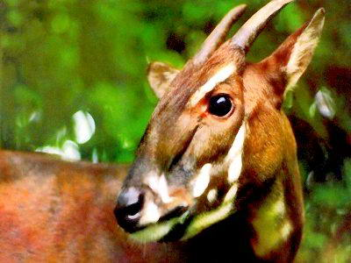
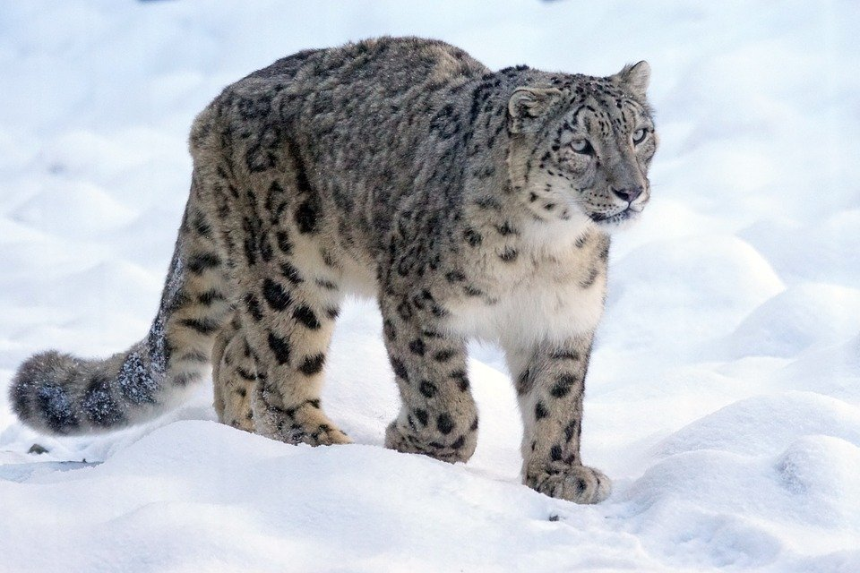
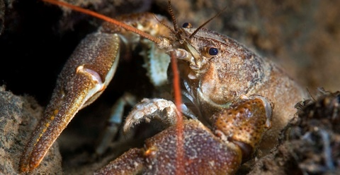
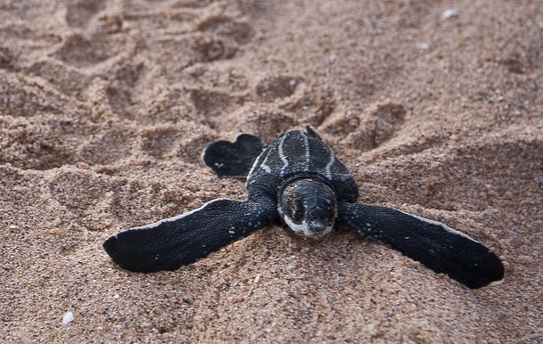
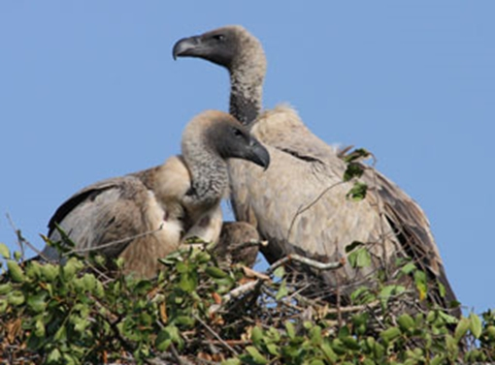
Pick a species…
lemur
saola (aka Asian unicorn!)
crayfish
snow leopard
turtle
vulture
Done?

Slide 9
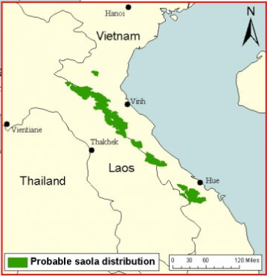

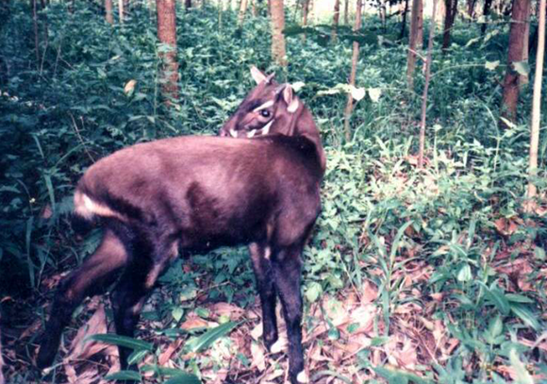
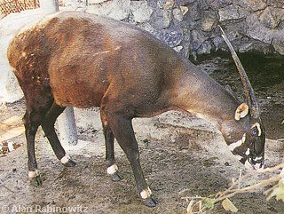
Saola Fact File
Discovered only 30 years ago (1992)
Closest living relatives are cattle
Largest land animal in the world that has NEVER been seen by a biologist in the wild
No one knows how many or if they are already extinct
Notes:
Lives only in Annamite mountains of Laos and Vietnam in Asia

Slide 10
Saola Threats
Hunting in Southeast Asia threaten many animals
Snares are set to catch animals
Animals for eating and traditional medicine
Saola are not hunted, but get caught in the snares

Slide 11

Saola Solutions
Similar to Arabian oryx and white rhino
Conservation breeding centre set up
Local rangers and keepers being trained to look after similar species
Camera traps, tracking (with dogs) and DNA techniques being used
Providing more protection to its home
Save another species?
Done?
Notes:
Arabian oryx and white rhino were both down to a handful of individuals before conservation breeding and protection in the wild brought them back up to healthy population size

Slide 12
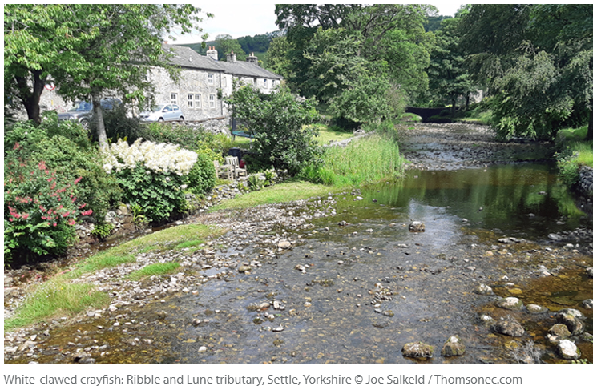
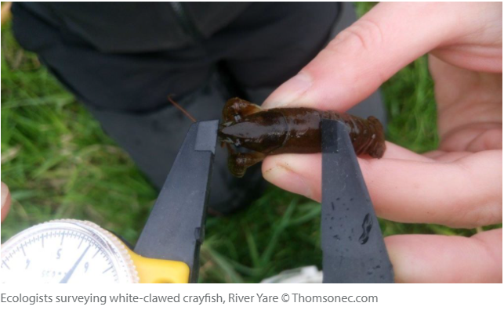

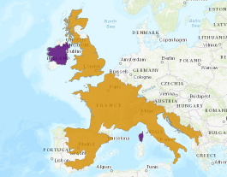
White-clawed crayfish Fact File
Freshwater: shallow rivers, streams, canals, reservoirs
Lives under stones, logs and tree roots
Needs vertical banks with overhanging plants
Omnivorous: bugs, dead matter and plants

Slide 13
White-clawed crayfish Threats
Invaders: US species ‘signal crayfish’ released from UK food farms
Signal crayfish eat all the food
Signal crayfish damage the homes
Signal crayfish spread a disease that kills white-clawed crayfish
Pollution threatens white-clawed crayfish
90% loss in some counties of UK

Slide 14
White-clawed crayfish Solutions
Trapping invasive species was tried, but may have made it worse!
Clean equipment carefully to avoid
transferring invasive crayfish or disease to different streams
Stop pollution reaching rivers and streams
Rewild with plants along riverbanks
Captive hatchery to increase population
Save another species?
Done?
Notes:
Trapping only got the large crayfish. These large crayfish eat the small crayfish, so by removing the large crayfish, more crayfish survive! Females lay 250eggs at a time

Slide 15

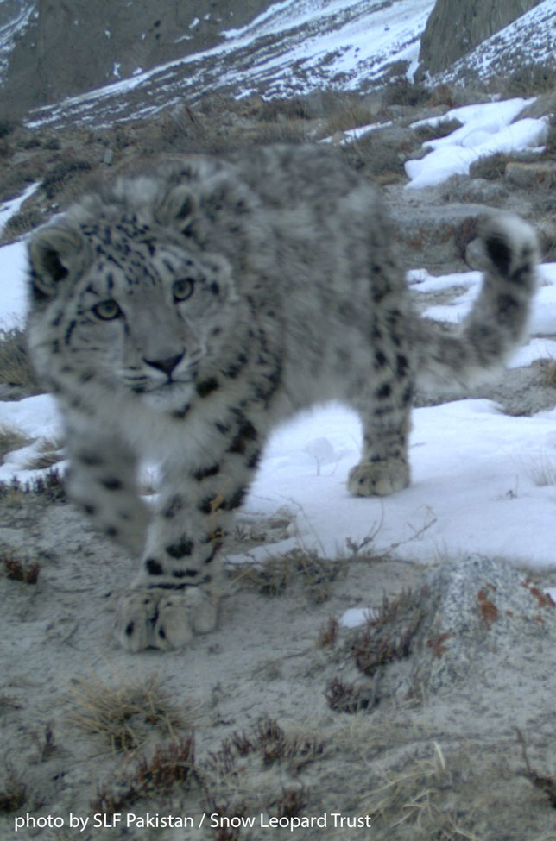
Snow leopard Fact File
Solo traveller – usually solitary
Gentle towards humans
Live in dry, bare, mountainous landscape
Carnivorous - hunt ibex (wild goat), argali sheep and blue sheep (bharal)
Live throughout the mountains of Central Asia across 12 countries (but mainly China – 60% of the population)

Slide 16
Snow leopard Threats
Killed for their beautiful fur
Herders live here with their sheep and goats (their livelihood) – snow leopards sometimes prey on them and the herders lose a lot of money
Herders then kill the snow leopard through anger and to stop it happening again
Snow leopard’s wild prey is also hunted too much

Slide 17
Snow leopard Solutions
Trained rangers and local communities in the fight against poaching
Environmental education for local children to protect wildlife
Train women to make items to sell to add an income to support herders’ losses
Camera traps and tracking to monitor
Livestock insurance and vaccination
Building predator-proof corrals
Save another species?
Done?
Notes:
Success as this species was endangered up until 6 years ago when a reassessment showed increase numbers and better management of threats and therefore ‘downgraded’ the status from endangered to vulnerable ☺

Slide 18
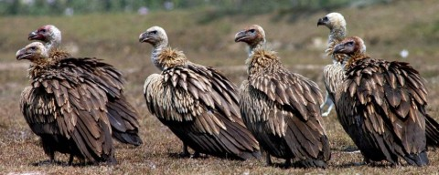
White-backed vultures Fact File
Nature’s cleaner
Large scavenger – only eats dead things!
Stops animals rotting & spreading disease
Its bald head helps keep clean when it sticks its head into its food!
Eat in large groups and can pick a carcass clean very quickly – therefore reducing flies that cause disease
Notes:
These are the Asian white-backed vultures of Pakistan and south Asia

Slide 19
White-backed vultures Threats
Population decline of 99% in last 20 years
Poisoning from a veterinary drug used to treat farm animals
Because vultures feed in large groups, the entire group can be killed when feeding on a treated farm animal carcass

Slide 20

White-backed vulture - Solutions
The veterinary drug has been banned as there is a vulture-safe alternative
Conservation breeding centres to help increase numbers again
Developing vulture-safe zones for release sites
Save another species?
Done?

Slide 21
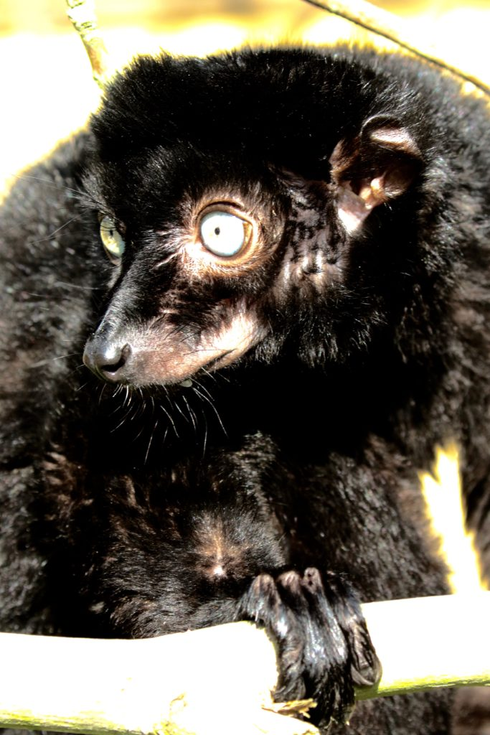
Blue-eyed black lemurs Fact File
DID YOU KNOW?
Only non-human primate with blue eyes!
Lives in Northwest Madagascar
Eats mainly leaves and fruits, but also insects, flowers and fungi
Male is black and female is brown

Slide 22
Blue-eyed black lemurs Threats
Mainly habitat loss – forest home is being cut down and burnt
Local communities very poor and clear forests to grow food for a living
Hunted for food
Hunted to be kept as pets

Slide 23
Blue-eyed black lemur Solutions
Link local communities with the importance of their wildlife
Train local communities to patrol the forest to prevent poaching and create clearings to protect from fire
Support students to attend school and pay teachers a better wage
Eco-tourism to give wildlife protection value
Reforestation – to replace forest loss
Captive breeding programme for this species
Save another species?
Done?

Slide 24
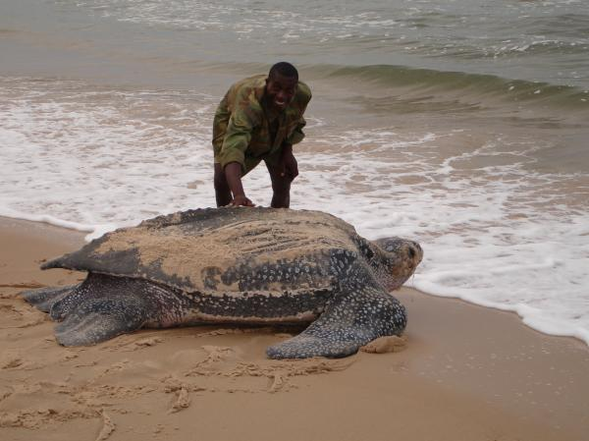
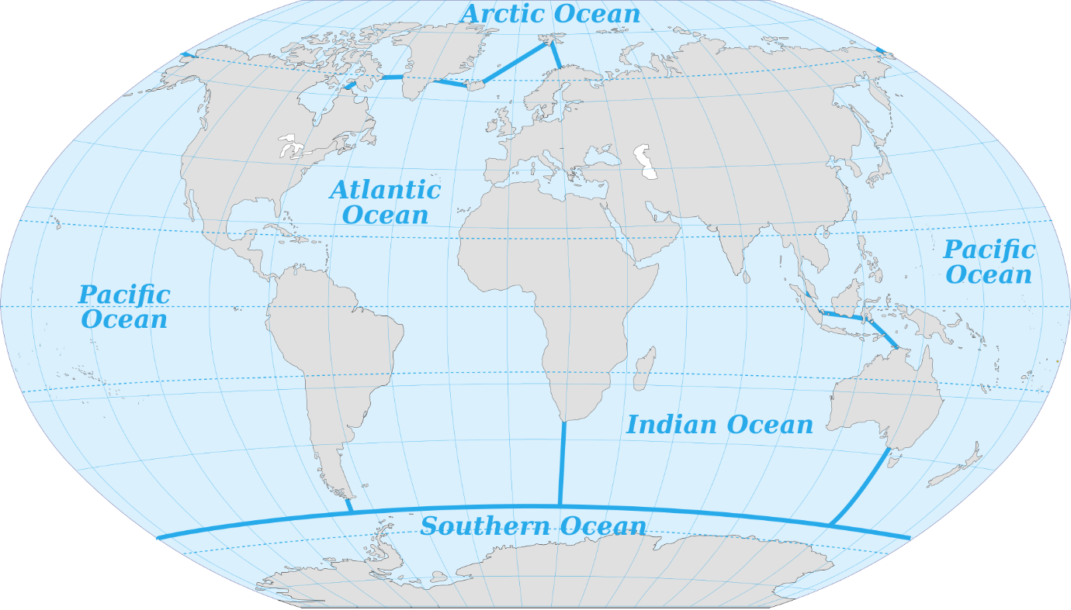
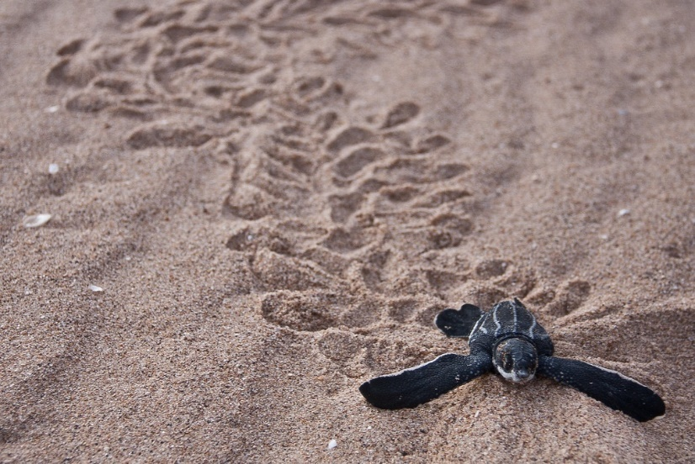
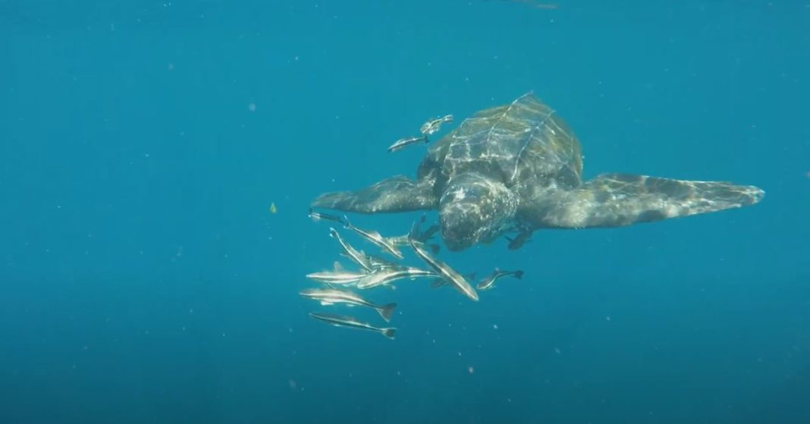
Leatherback Turtle Fact File
DID YOU KNOW?
Largest sea turtle species
Lives: migrates - Atlantic & Pacific Ocean
Eats: jellyfish
Eggs laid on a beach and hatchlings make their way across the sand to the sea

Slide 25
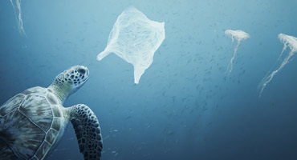
Leatherback Turtle Threats
People take their eggs from beaches
Caught in fishing hooks and nets
Loss of suitable beaches for egg-laying
Coral reefs and sea grasses are being destroyed and this is where they feed
Mistake plastic bags for jellyfish

Slide 26
Leatherback Turtle Solutions
Tell local communities about the threats
Train local rangers to protect nest sites
Educate fishermen about new nets and hooks
Satellite tags on the turtles help researchers understand where they migrate
Don’t litter! Organise litter picks. Reduce your waste.
Save another species?
Done?

Slide 27

Congratulations
YOU
Conservation Officer

Slide 28

Well done Elloughton Primary School
Wildlife has a great future in your hands

